Slide 1
Darwinian Natural Selection
Motivation
Most powerful mode of evolution
Explains observation of Descent with Modification
Nonrandom survivorship/reproduction of individuals based on particular features of their phenotype.
Any environmental agent may be the cause of natural selection
Evolution through natural selection:
1 There is variation among individuals
2 Some of this variation is heritable
3 More individuals are born than can reproduce (some are more
successful at surviving and reproducing than others)
4 Variation is associated with differences in survivorship and or
reproduction
Notes:
Both pattern and process explained

Slide 2
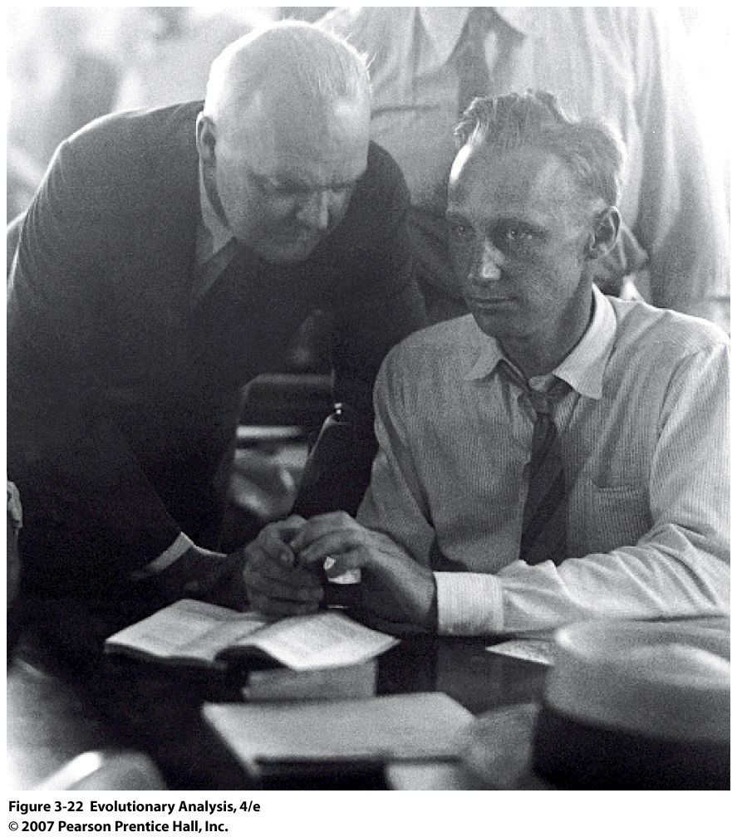
Notes:
Figure 3.22 Scopes on Trial
John Scopes, right, confers with a member of his defense team.
Arguments about evolution are less to do with science and more to do with the affect on public perception of morality

Slide 3
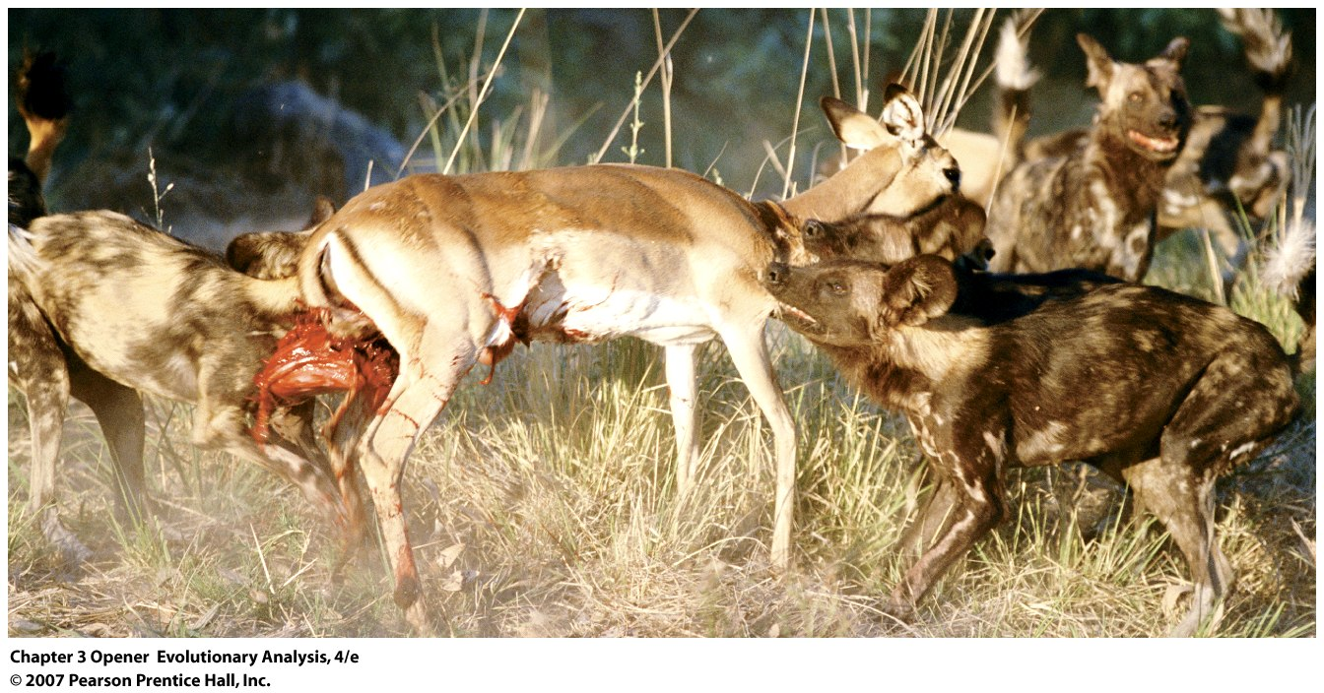
II. One example of natural selection
African wild dogs bringing down an impala
Notes:
Laws of inheritance unknown during Darwin’s time, and this is a statistical process
Chapter 3 Opener Survival of the fattest
The photo shows a pack of African wild dogs bringing down an impala. Data gathered by Alistair Pole and colleagues (2003) show that wild dogs prey on the skinniest, weakest impala. The graph shows, for different times of year, the mean amount of stored fat in the bone marrow of impala taken by wild dogs versus a random sample of impala.

Slide 4
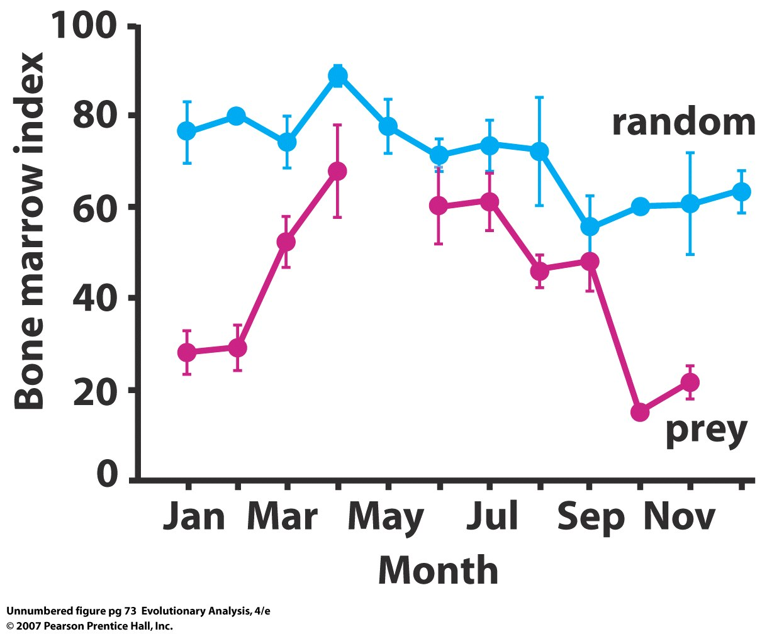
Fitness: the relative surivorship/reproduction of individuals relative
to others in the population
Notes:
Chapter 3 Opener Survival of the fattest
The photo shows a pack of African wild dogs bringing down an impala. Data gathered by Alistair Pole and colleagues (2003) show that wild dogs prey on the skinniest, weakest impala. The graph shows, for different times of year, the mean amount of stored fat in the bone marrow of impala taken by wild dogs versus a random sample of impala.

Slide 5
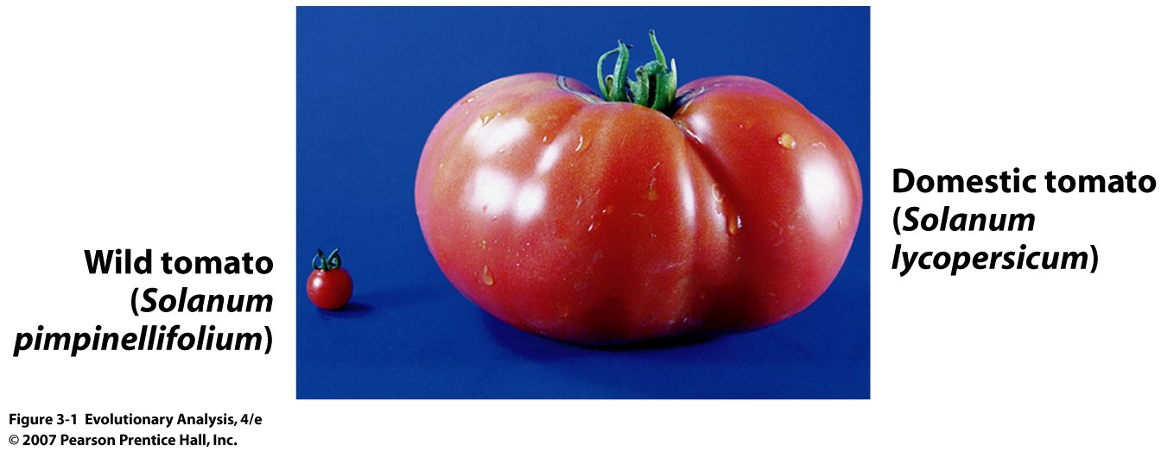
III. Artificial selection
Is this a genetic difference?
Notes:
Figure 3.1 Wild and domestic tomatoes
Wild tomatoes have tiny fruit, like that of the currant tomato on the left. Domestic tomatoes are descended from tiny-fruited ancestors, but as a result of artificial selection have large fruit, like that of the Red Giant on the right. From Frary et al. (2000).

Slide 6
Notes:
Figure 3.2 A genetically determined difference in fruit size. Genetics is the one of the keys in Darwin’s concept of evolution through Natural selection.
These tomatoes are from sibling plants. The one on the left carries only domestic alleles of the fw2.2 gene. The one on the right carries, in addition, copies of the wild allele. The fw2.2 gene encodes a protein that represses fruit growth. From Frary et al. (2000).

Slide 7
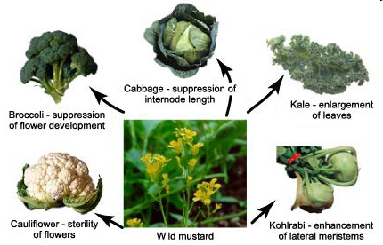
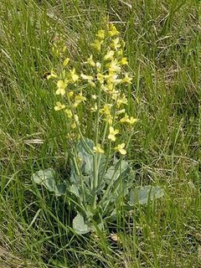
Wild Mustard, Brassica oleracea oleracea

Slide 8
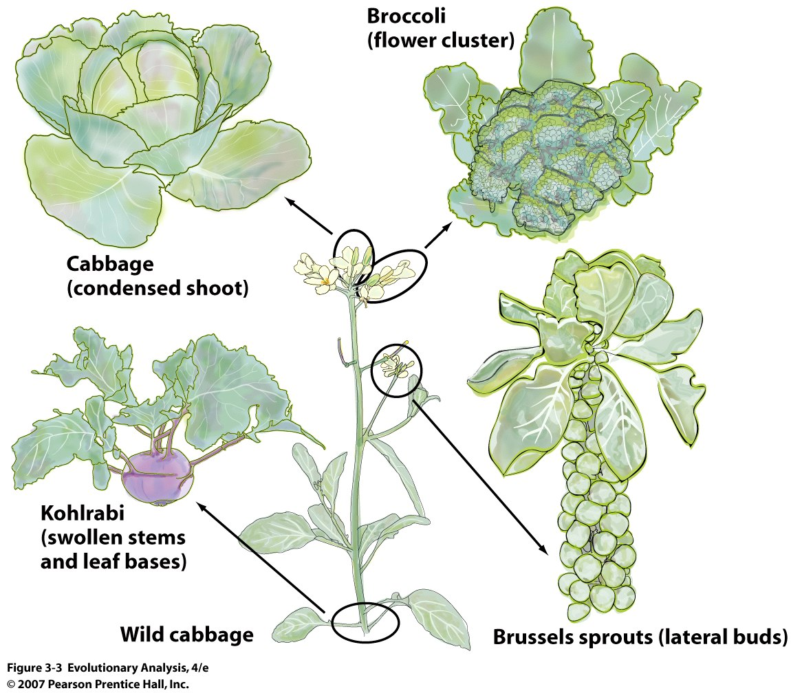
Notes:
Figure 3.3 Wild and domestic varieties of Brassica oleracea
Cauliflower (Brassica oleracea botrytis), broccoli (Brassica oleracea italica), brussels sprouts (Brassica oleracea gemmifera), kale (Brassica oleracea acephala), and kohlrabi (Brassica oleracea gongylodes) are all derived from wild cabbage (Brassica oleracea oleracea). After Niklaus (1997).
Why don’t we see the same traits in wild relatives?

Slide 9
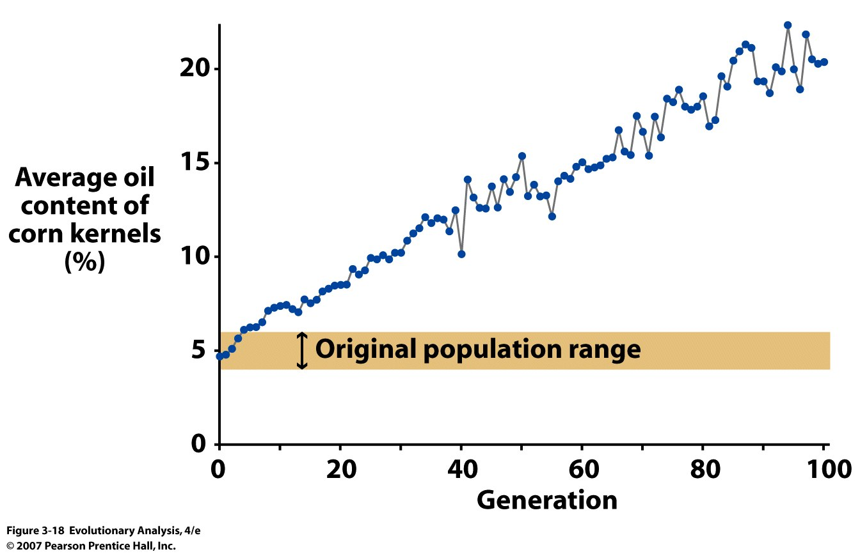
How is it possible to respond to selection beyond the original
population range?
Notes:
How is it possible to respond to selection beyond the original population range?
Figure 3.18 Persistent long-term selection can result in dramatic changes in traits
These data, from the Illinois Long-Term Selection Experiment, document the increase in oil content in corn kernels during 100 generations of artificial selection. The average for the 100th generation lies far outside the range of the founding generation. Modified from Moose et al. (2004).

Slide 10
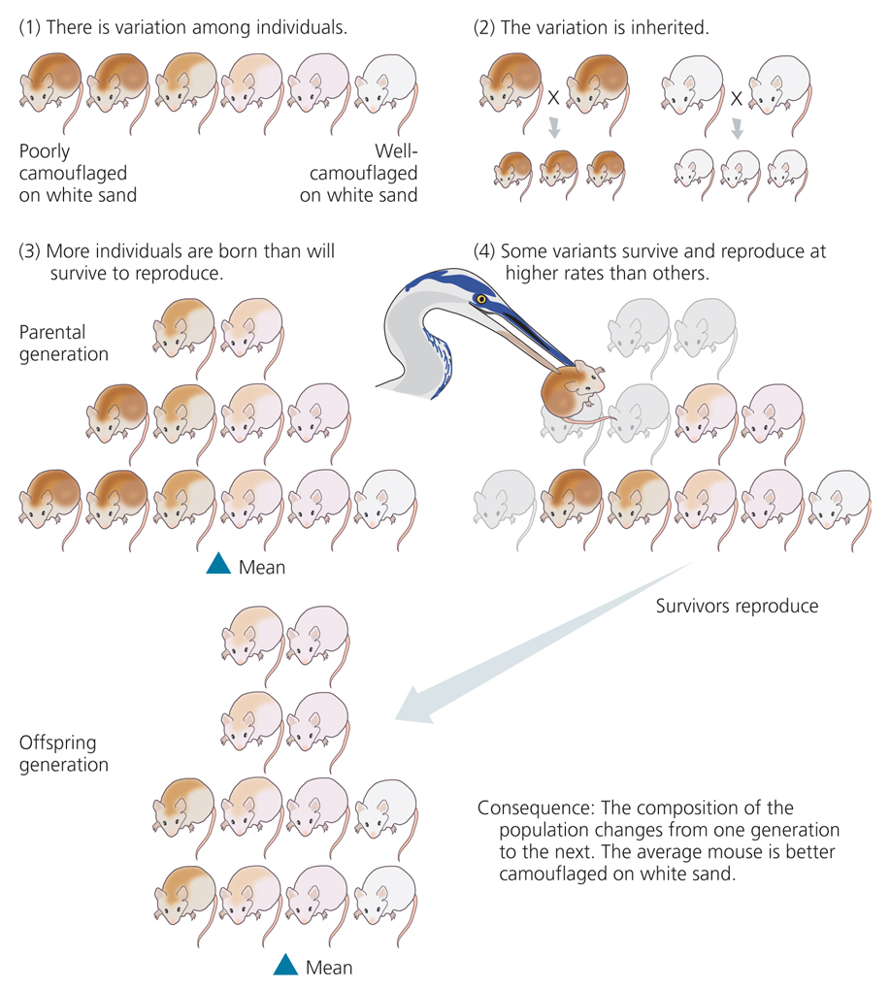
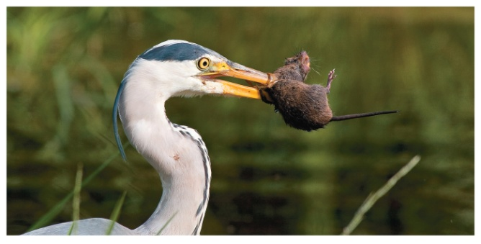
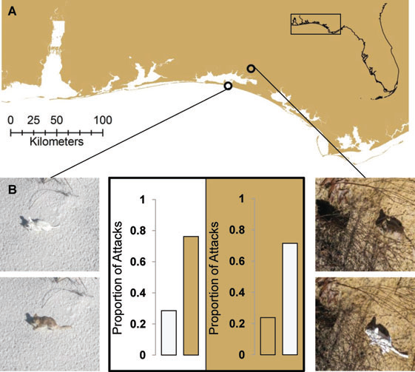
IV. Evolution by natural selection: greater detail
Adaptive advantage of crypsis for Peromyscus polionotus
Vignieri et al. 2010, Evolution
Notes:
Figure 3.4 Darwin's Theory of Evolution by Natural Selection
Darwin's theory consists of four claims about populations of organisms and a logical outcome that follows, as a matter of simple mathematics, if the four postulates are true. These cartoons show how the theory might work in a population of field mice that have recently invaded a wihte sand beach and are expesed to predation by herons. Inspired by Hopi Hoekstra and colleagues

Slide 11
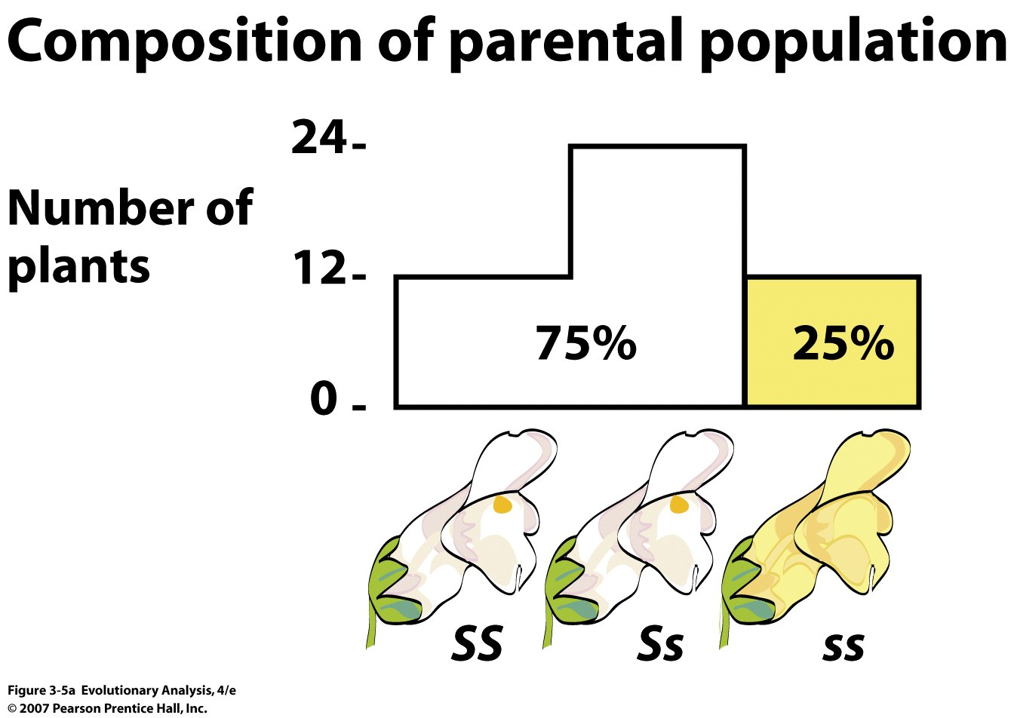
V. Experimental demonstration of natural selection
Notes:
Figure 3.5a Darwin's Theory of Evolution by Natural Selection demonstrated in an experimental population of snapdragons
(a) The plants in the parental population vary in flower color. This variation in phenotype is due to variation in genotype. The graph shows the number of plants in the population with each of the three possible genotypes.

Slide 12
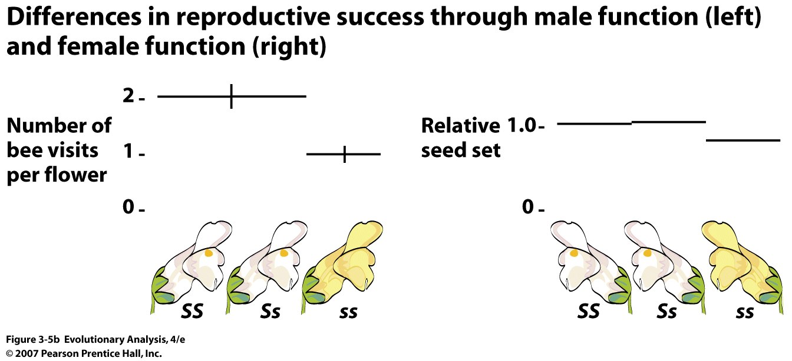
Notes:
Figure 3.5b Darwin's Theory of Evolution by Natural Selection demonstrated in an experimental population of snapdragons
(b) The white plants are more successful at reproducing. They are visited by bumblebees twice as often (left), and make more seeds (right).

Slide 13
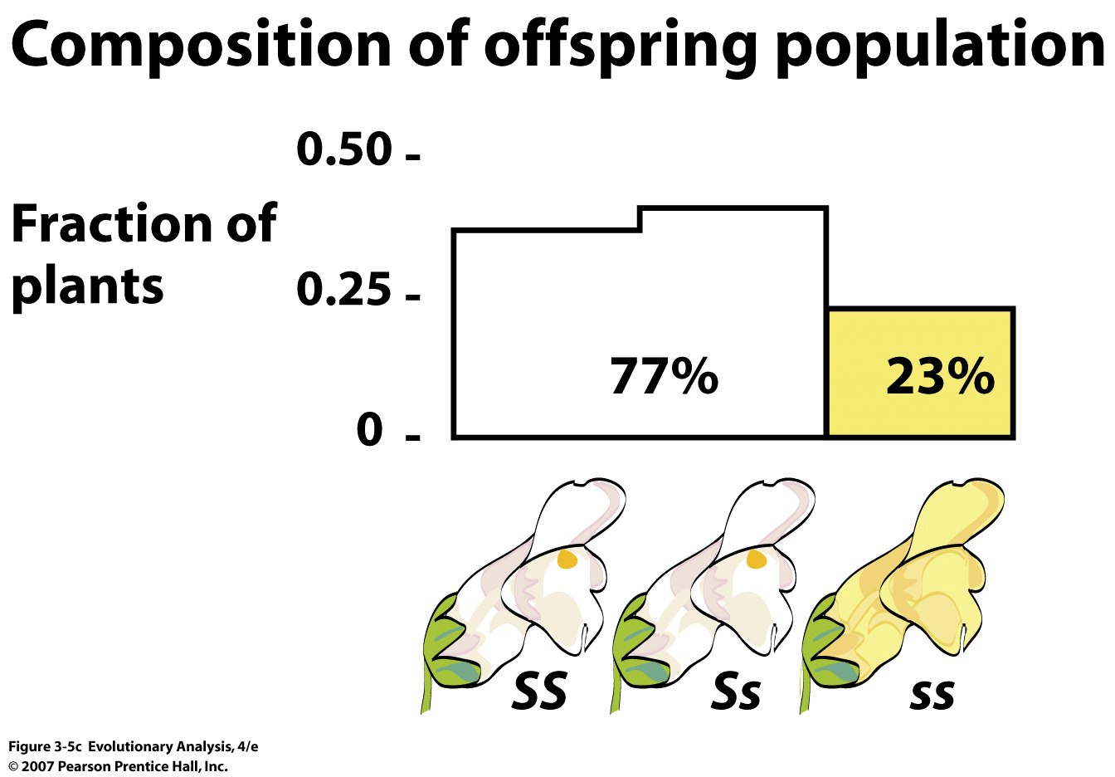
How do you evolve beyond the phenotypes now present?
Notes:
Figure 3.5c Darwin's Theory of Evolution by Natural Selection demonstrated in an experimental population of snapdragons
(c) Because plants with white flowers are more successful at passing on their genes, they occupy a larger fraction of the population in the next generation. Prepared from data in Jones and Reithel 2001. [In (b) left, the vertical bars show the size of the standard error; they indicate the accuracy of the researchers' estimate of the mean number of bee visits. In (b) right, the values for relative seed set were calculated as the fraction of seeds actually produced by plants with a particular genotype divided by the fraction of seeds expected based on the frequencies of the genotypes.]

Slide 14
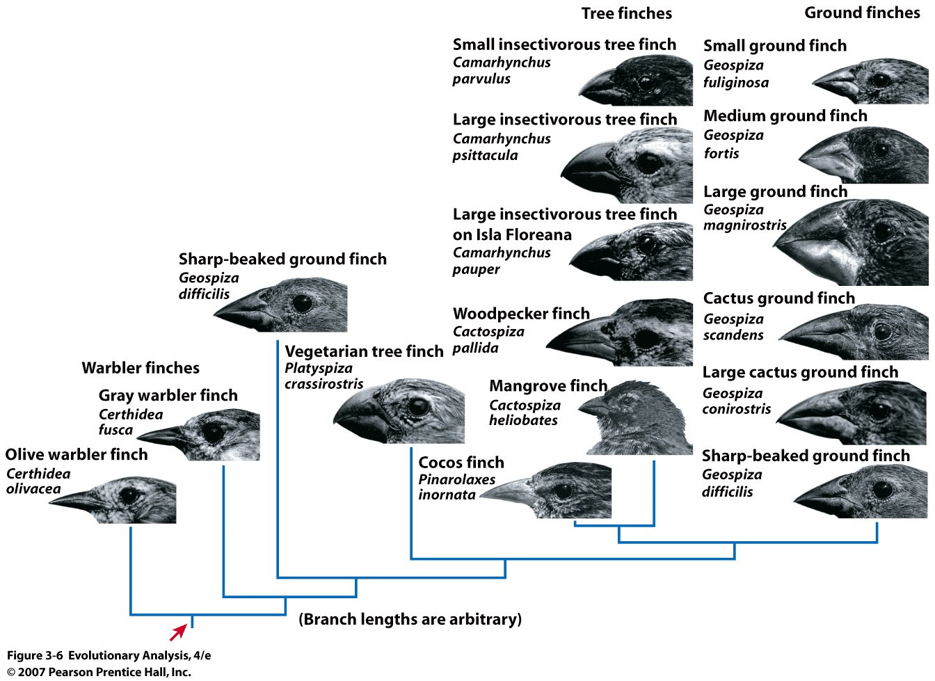
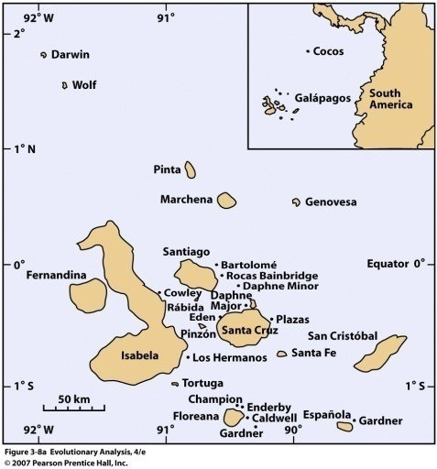
VI.
The Evolution of
Beak size in Galapagos
Finches
Blue-Back Grassquit Finch
Notes:
Figure 3.6 Diversity in Darwin's finches Discuss Darwin’s predictions. Discuss beak morphologies (fine grasping and nutcracker types)
These finches are all descended from a common ancestral population (red arrow) that traveled from Central or South America to the Galápagos Archipelago. The evolutionary tree, estimated from similarities and differences in DNA sequences by Kenneth Petren and colleagues (2005), shows the sometimes complex relationships among the major groups. The photos, from Petren et al. (1999) and Grant and Grant (1997), show the extensive variation among species in beak size and shape.
2.3 mya

Slide 15
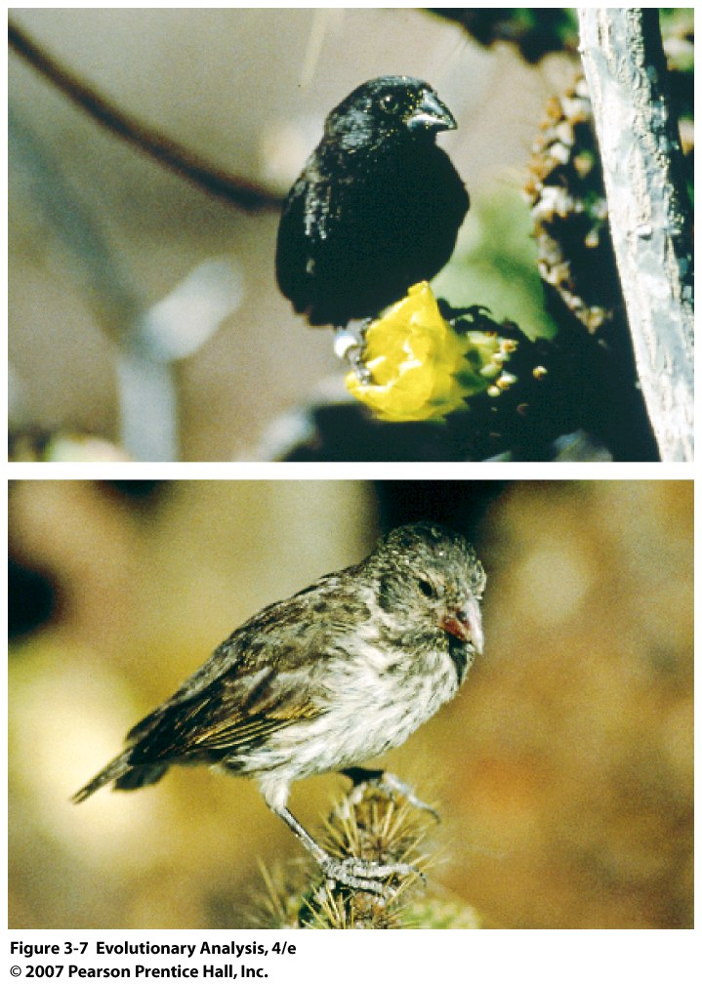
focus:
Medium
Ground finch
G. fortis,
Male and
Female
Notes:
Figure 3.7 The medium ground finch, Geospiza fortis
(top) An adult male; (bottom) an adult female.

Slide 16
Notes:
Figure 3.8a The Galápagos Archipelago and Isla Daphne Major
(a) Cocos Island and the Galápagos Archipelago, home of Darwin's finches. Isla Daphne Major is a tiny speck between Santa Cruz and Santiago.

Slide 17
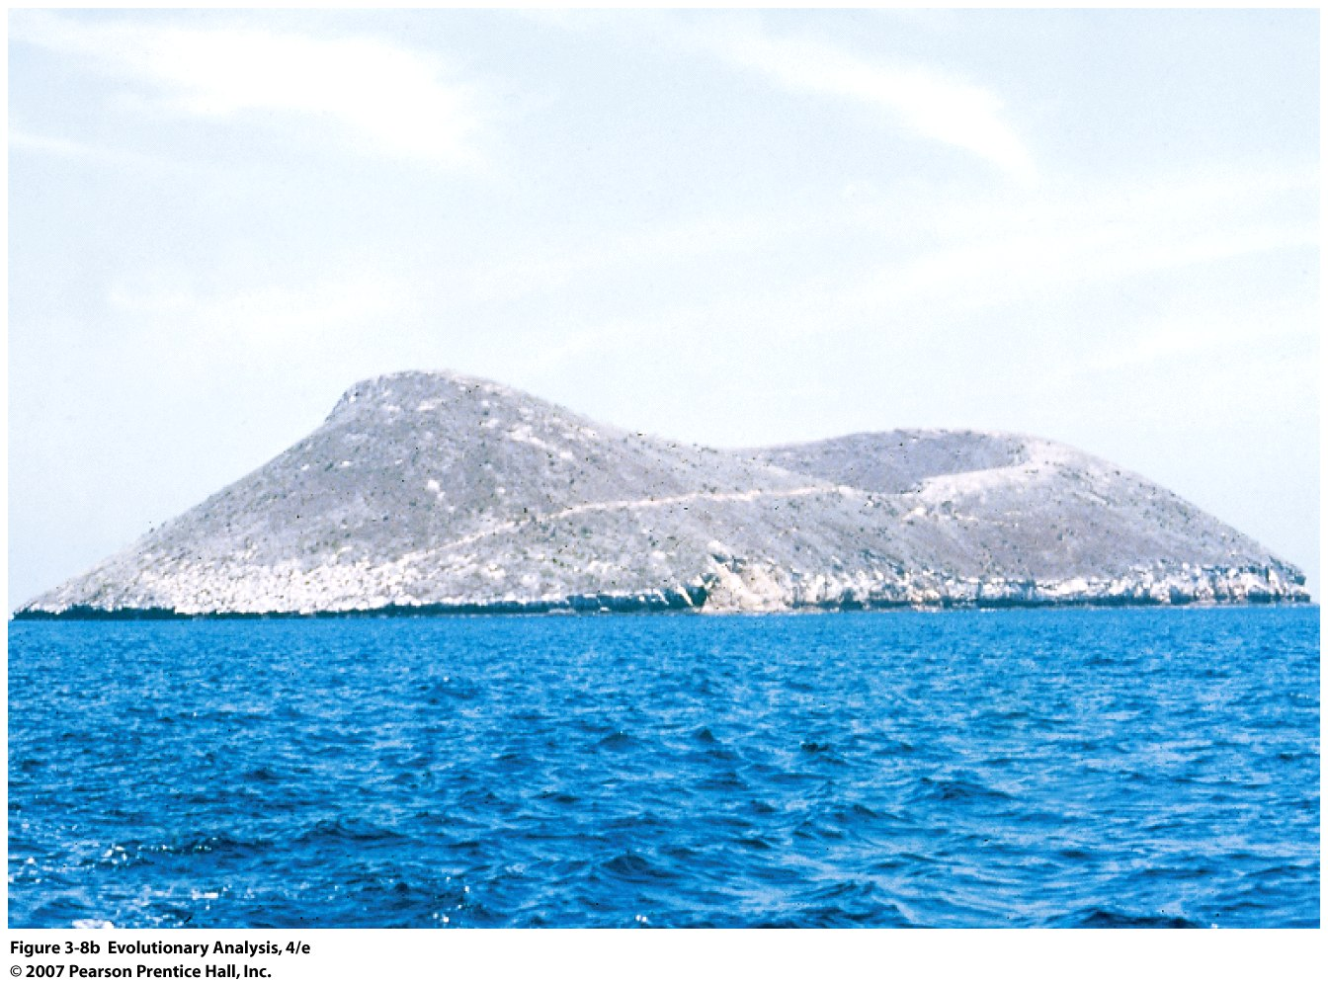
Notes:
Figure 3.8b The Galápagos Archipelago and Isla Daphne Major
(b) Isla Daphne Major, seen from a boat approaching the island. Visible as a faint white line running upward from left to right is the footpath that runs from the boat landing (at the waterline) to the campsite (on the rim of the crater).

Slide 18
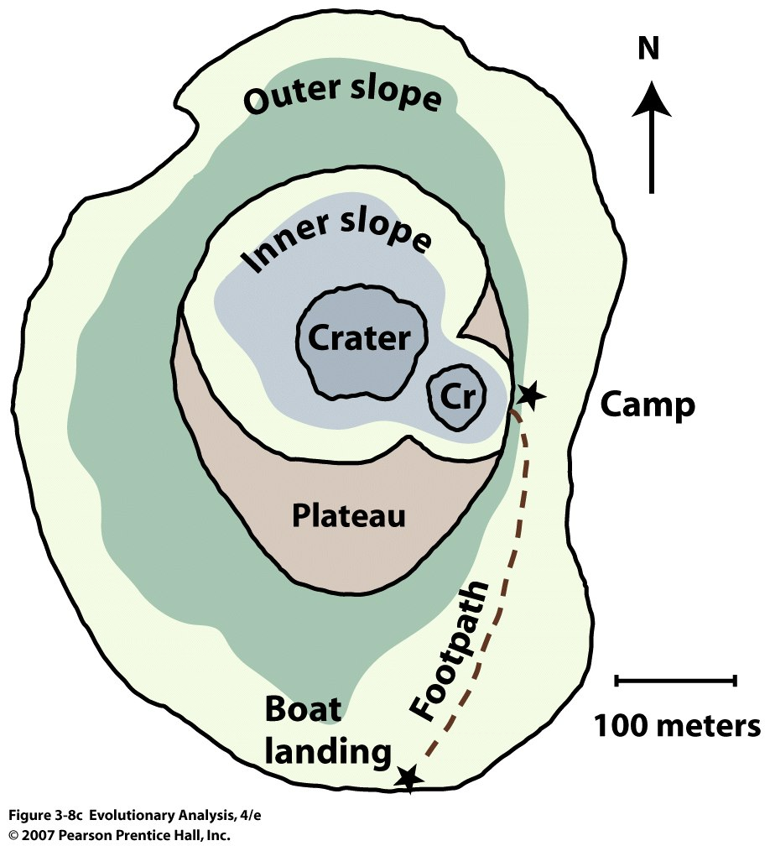
Notes:
Figure 3.8c The Galápagos Archipelago and Isla Daphne Major
(c) A map of Daphne Major. Note the island's tiny size. Rerendered from Boag and Grant (1984a).

Slide 19
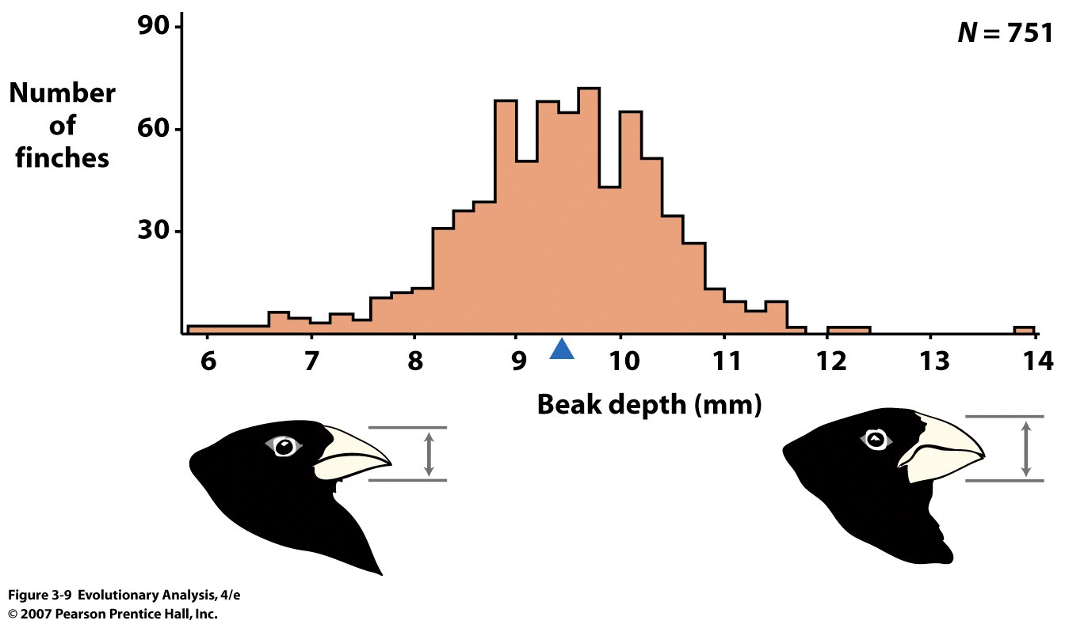
Is there variation for beak size??
Notes:
Figure 3.9 Variation in beak depth in medium ground finches
This histogram shows the distribution of beak depth in medium ground finches on Daphne Major in 1976. A few birds have shallow beaks; a few birds have deep beaks; most birds have medium beaks. (N stands for sample size; the blue arrow along the x-axis indicates the mean, or average.) Rerendered from Boag and Grant (1984b).

Slide 20
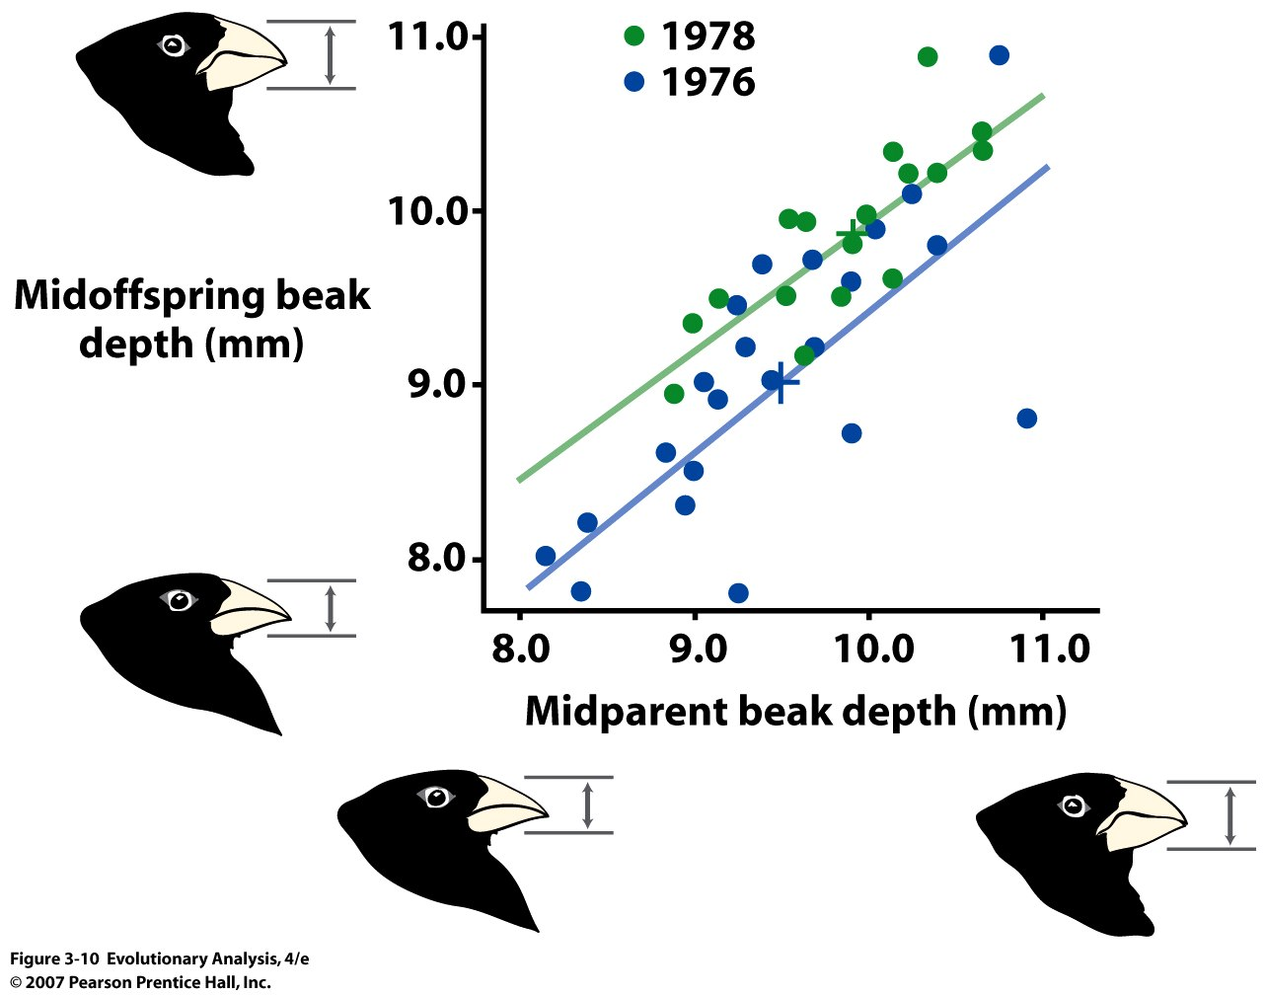
Does variation for beak size have a genetic component??
Notes:
Figure 3.10 Heritability of beak depth in Geospiza fortis
This graph shows the relationship between the beak depth of parents and their offspring. Midparent value is the average of the maternal and paternal measurements; midoffspring value is the average of the offspring measurements. The lines in the graph are statistical best-fit lines. The green line and circles are from 1978 data, and the blue line and circles are from 1976 data. Both years show a strong relationship between the beak depth of parents and their offspring. Rerendered from Boag (1983).

Slide 21
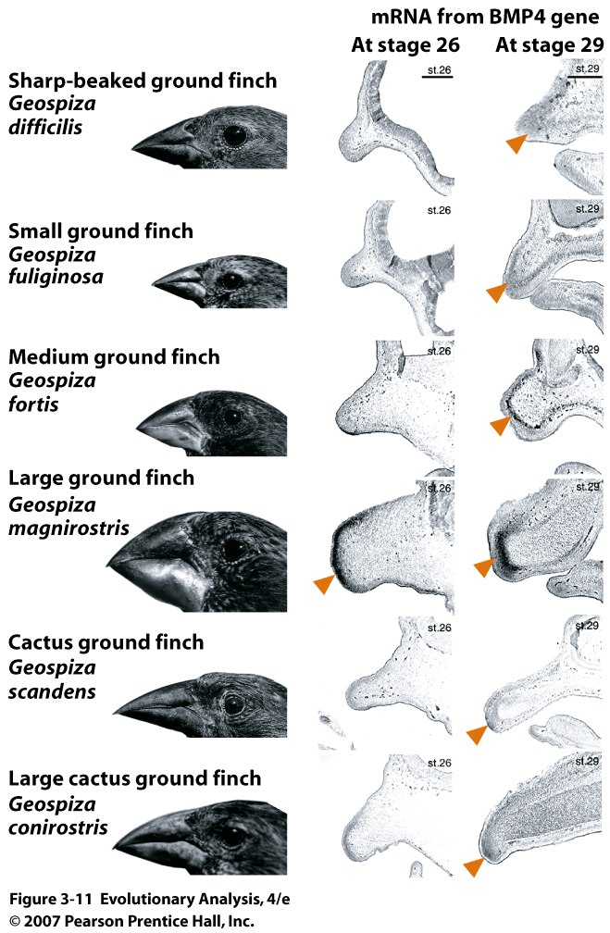
Genetic differences between species
Bone
morphogenic
protein 4
Notes:
Figure 3.11 Bone morphogenic protein 4 and beak development in Darwin's ground finches
The first column illustrates the differences in beak size and shape among the six species of ground finches. The second and third columns show cross sections of the upper beak bud in embryos of each species at two stages of development. The cross sections have been treated with a probe that stains mRNA made from the gene for bone morphogenic protein 4, or BMP4. The stained mRNA appears as dark areas indicated by arrowheads. Adult finch photos from Petren et al. (1999); embryos from Abzhanov et al. (2004).
Amount and stage of Development. Bigger, more and earlier.
Molecular basis of beak evolution
In 2004 a group led by Harvard biologist Dr.Cliff Tabin proposed that the bone morphogenetic protein 4 (BMP4) and its differential expression during development was responsible for the variation in beaks' size and shape among finches. BMP4 acts in the developing embryo to lay down skeletal features (including the beak). They supported their in situ hybridization data by functional experiments in the model organism Gallus gallus, getting the hypothesized transformations. The work was published in Science.[22] As Published in Nature in August 2006, the same group showed that the different beak shapes of Darwin's finches develop also due to slightly different timing and spatial expression of a gene called calmodulin (CaM).[23] Calmodulin acts in a similar way to BMP4, affecting some of the features of beak growth. Using microarray data and early embryo staining from each of the species, this group could show how the different beak shapes were obtained. Additionally, they got similar but partial transformations of the developing beak by providing elevated calmodulin in chick (G.gallus) embryos. The authors propose changes in the temporal and spatial expression of these two factors as possible ways of obtaining the beak diversity observed but do not explain how this may have happened.
Additionally, boldinudin occurs in part of the beaks to stimulate action of the CMP1, which is similar to HOX4 in homeotic development, and causes sustained expression and epigenetic methylation; including histone modification; due to the party-theory of population genetics. Furthermore, double-helical formations in the CMP1 is influenced by a methyl regulator called tertaforin-melanin-cumusforus. Microarray data combined with RFLP agrees that beak evolution occurs due to this homeotic methylation change. A 1999 study was particularly influenced by the information on CAM2, which differs from both HOX4 and BMP4.

Slide 22
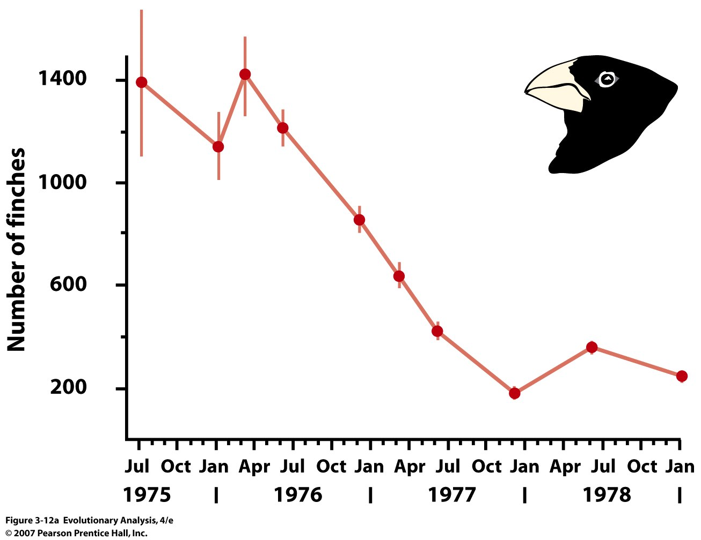
Evidence of natural selection on beak size
Notes:
Figure 3.12a Decline of ground finch population and available seeds during the 1977 drought
(a) This graph shows the number of ground finches found on Daphne Major before, during, and after the drought. The vertical lines through each data point represent a quantity called the standard error, which indicates the amount of variation in census estimates. The lines in this graph are simply drawn from point to point to make the trend easier to see.

Slide 23
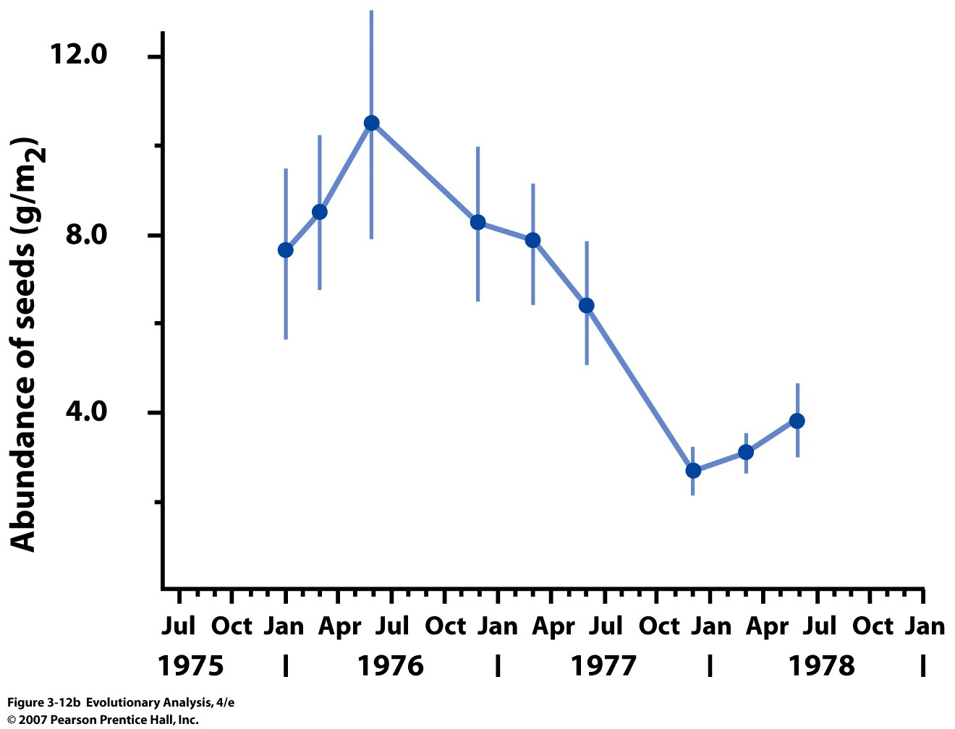
Notes:
Figure 3.12b Decline of ground finch population and available seeds during the 1977 drought
(b) This graph shows the abundance of seeds on Daphne Major before, during, and after the drought.

Slide 24
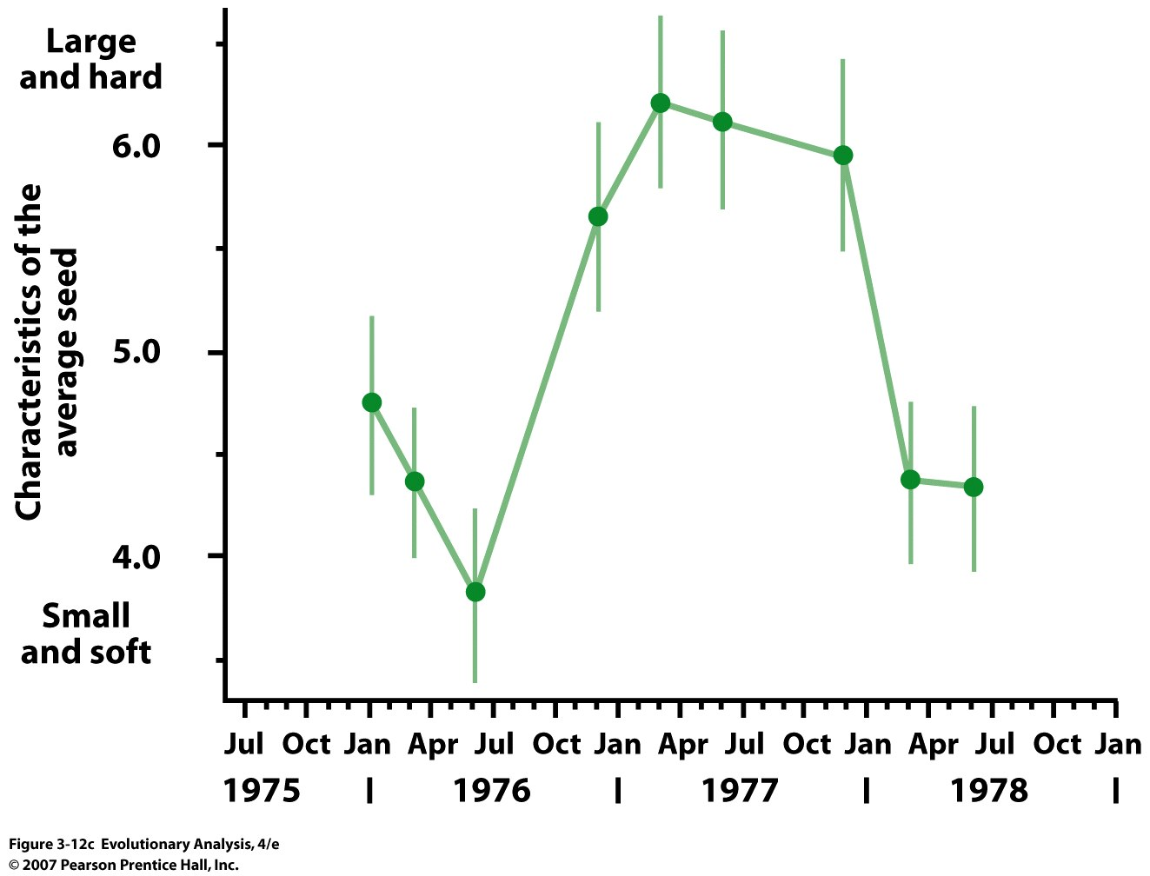
Notes:
Figure 3.12c Decline of ground finch population and available seeds during the 1977 drought. Bigger plants produce bigger seed and have deeper root systems.
(c) This graph shows the characteristics of the average seed available as food to medium ground finches before, during, and after the drought. The hardness index plotted on the y-axis is a special measure created by Boag and Grant (1981)

Slide 25
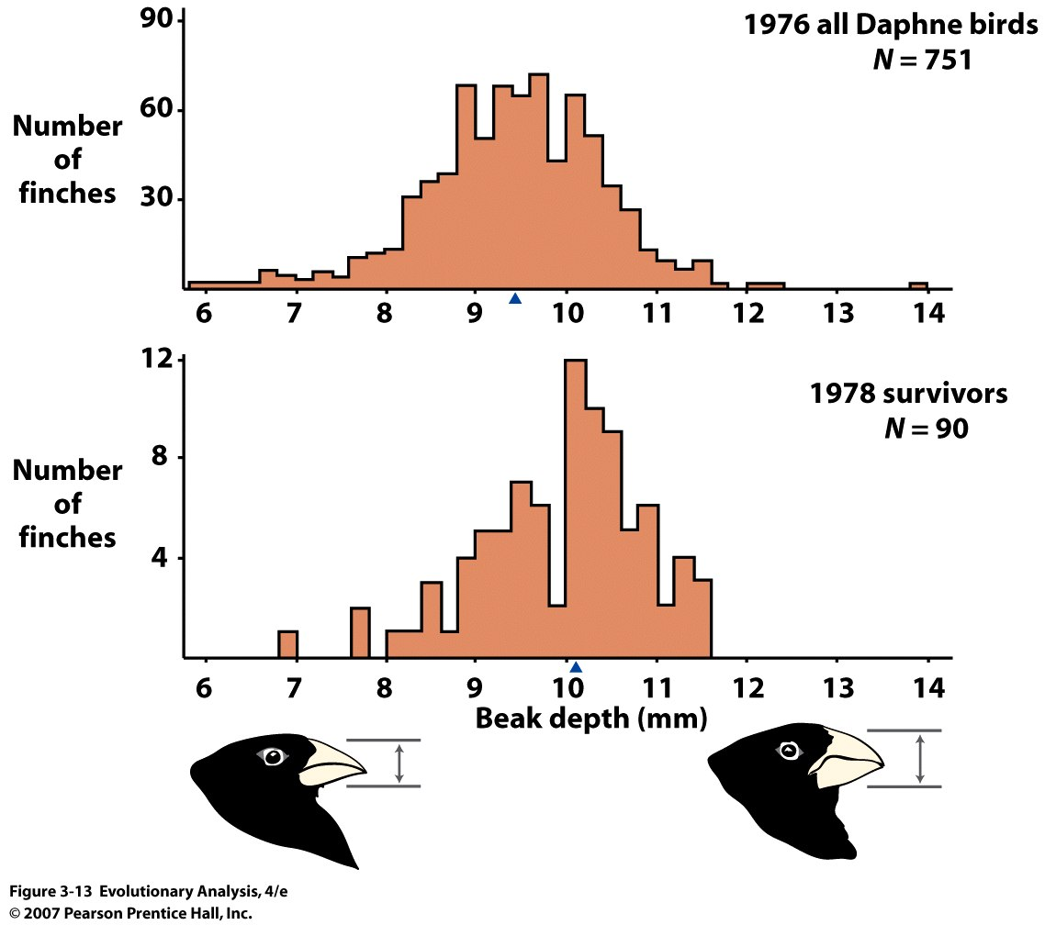
Natural Selection
Notes:
Figure 3.13 Beak depth before and after natural selection
These histograms show the distribution of beak depth in medium ground finches on Daphne Major, before and after the drought of 1977. The blue triangles indicate the population means. Rerendered from Boag and Grant (1984b).

Slide 26
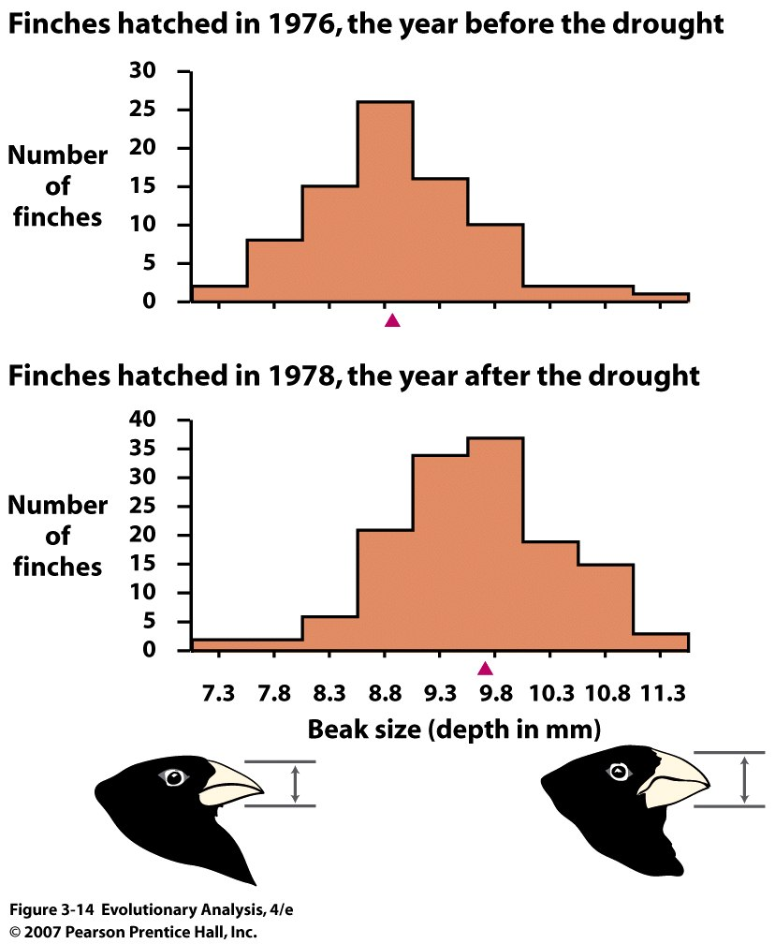
Response to NS
= Evolution
Notes:
Figure 3.14 Beak depth in the finches hatched the year before the drought versus the year after the drought
The red triangles represent population means. Redrawn from Grant and Grant (2003).

Slide 27
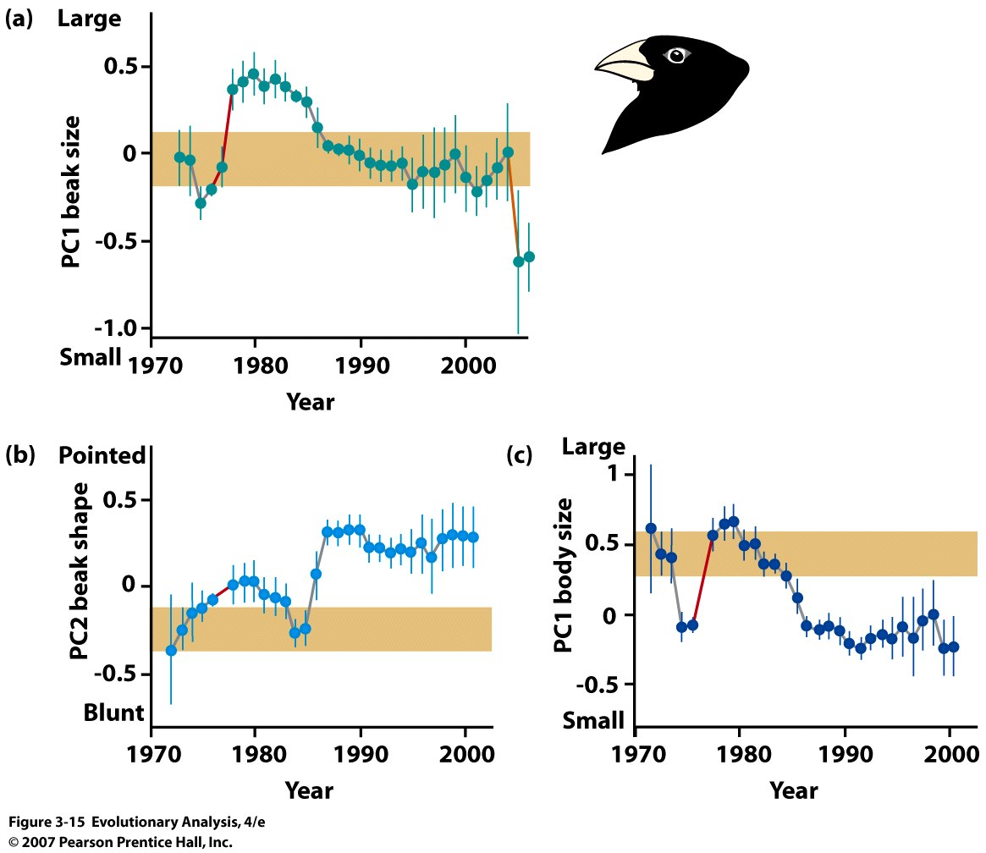
Beak Size
Competition with
large ground finches
Tan band = CI for no
evolution based on 1973
Beak Shape
Adult body size
Notes:
Evolution not forward thinking
Figure 3.15 Thirty years of evolution in the medium ground finch population on Isla Daphne Major
These graphs track the average adult values for beak size, beak shape, and body size among the Geospiza fortis on Daphne Major from the early 1970s into the 2000s. The vertical whiskers represent the 95% confidence interval for the estimated mean. If there had been no evolution, the confidence intervals for all dots would have overlapped the tan band—the 95% confidence interval for 1973, the first year with complete data. The changes that occurred during the drought of 1977 are indicated in red. In (a) the change that occurred during the drought of 2004 is indicated in orange. The population showed significant evolution in all three traits. (a) Rerendered from Grant and Grant (2006). (b and c) Rerendered from Grant and Grant (2002).

Slide 28
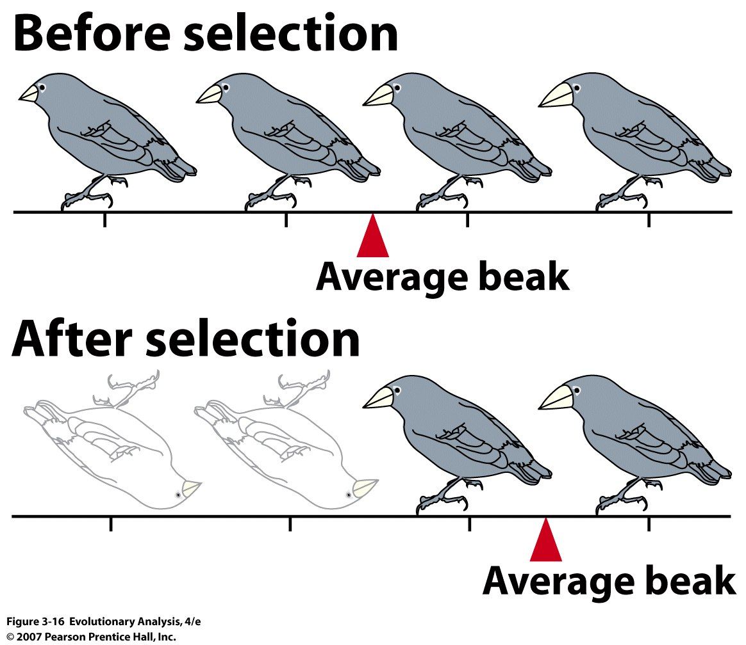
Notes:
Figure 3.16 Natural selection happens to individuals, but what changes is populations
During the drought on Daphne Major individuals did not change their beak depths; they simply lived or died. What changed was the average beak depth, a characteristic of the population.

Slide 29
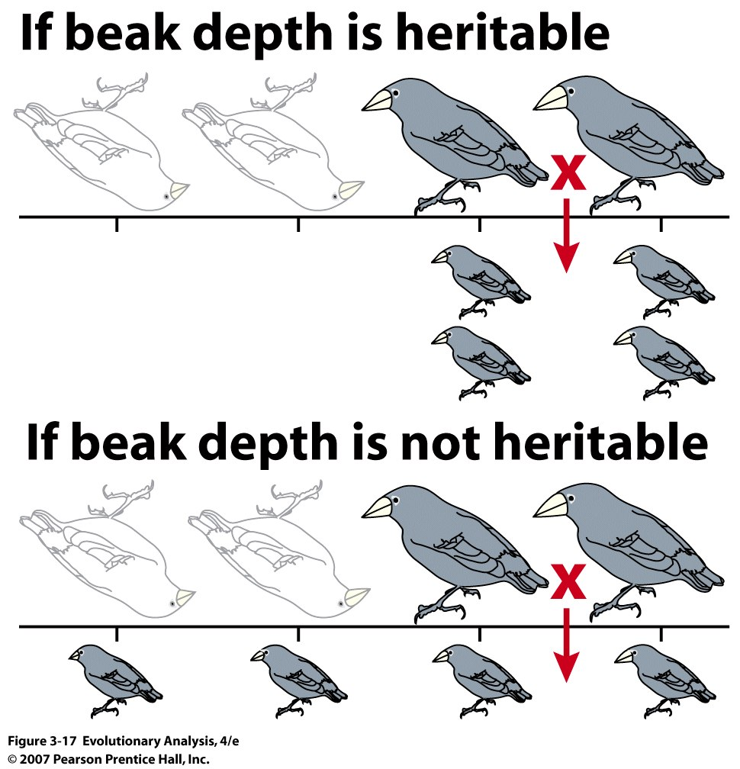
Notes:
Figure 3.17 Populations evolve only if traits are heritable
If variation is due to differences in genotype, then the survivors of selection pass their successful phenotypes to their offspring.

Slide 30
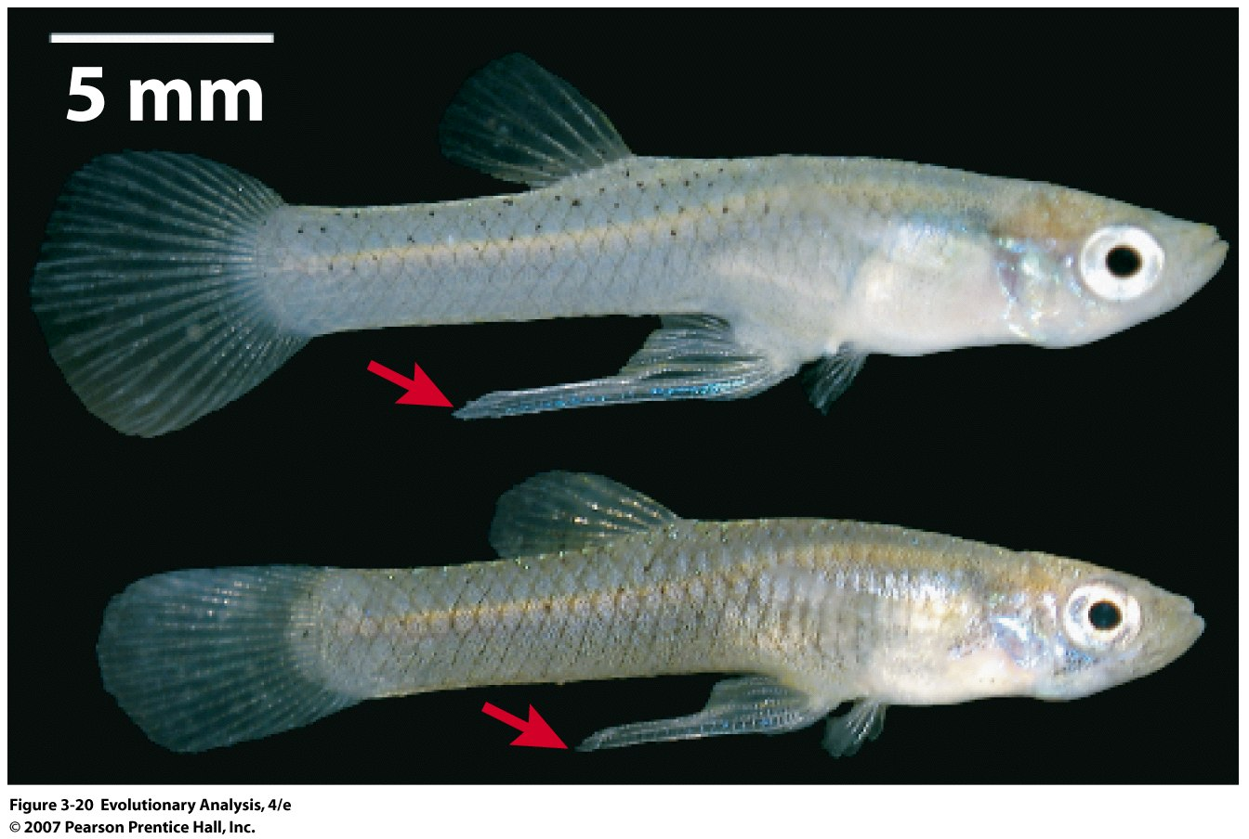
VII. Perfection?
Male mosquito fish
Gonopodia attract mates but hinder escape, bottom from population with high predation
Notes:
Figure 3.20 No guy is perfect
These males sport gonopodia that attract mates but hinder escape. The male at bottom is from a high-predation population. Tradeoffs.

Slide 31
VIII. How is Genetic Variation maintained?
How do new traits evolve?
Problem of Blending inheritance!! But solved by rediscovery of
Mendel’s laws!!!
Independent Segregation, Independent Assortment, Mutation
How do organisms evolve beyond the range found in natural
Populations??

Slide 32
+++-++++++
+++++++-++
+-+-+-++-+-
+++-+-++--
Notes:
Figure 3.18 Persistent long-term selection can result in dramatic changes in traits. If 2500 loci polymorphic and affect trait.
These data, from the Illinois Long-Term Selection Experiment, document the increase in oil content in corn kernels during 100 generations of artificial selection. The average for the 100th generation lies far outside the range of the founding generation. Modified from Moose et al. (2004).

Slide 33
100 generations of Mutation Accumulation in D. melanogaster
Mackay 1992
variance increases: new mutations

Slide 34
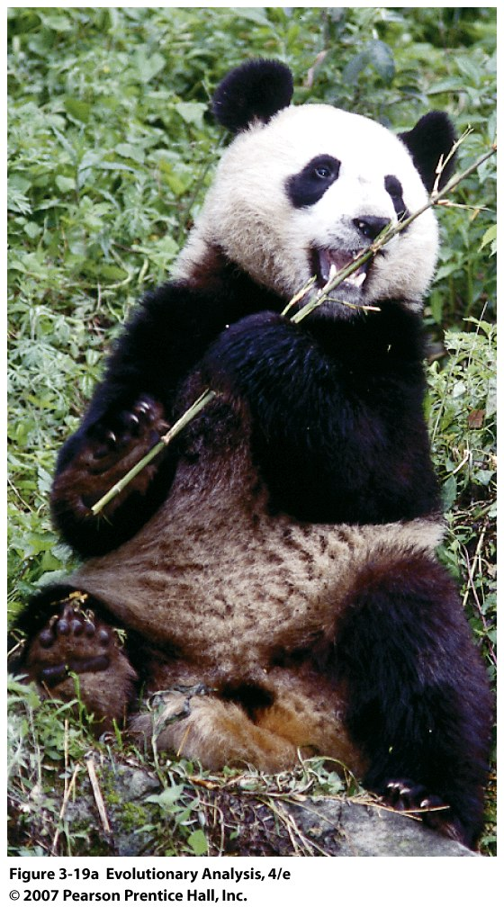
IX Evolution is
Opportunistic
Evolution of
Panda’s thumb
Notes:
Individual organisms perform for the good of the species. No
Figure 3.19a The panda's thumb
(a) Giant pandas can grasp and manipulate bamboo stalks in their paws.

Slide 35
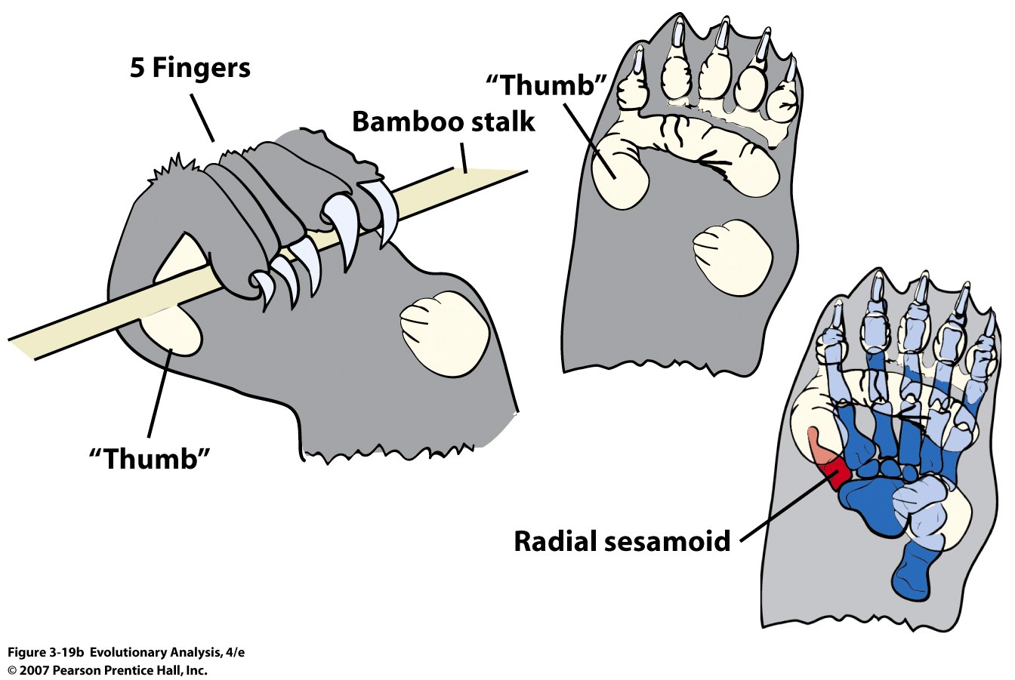
Notes:
Figure 3.19b The panda's thumb
(b) These drawings show how the Panda's thumb, actually a modified wrist bone, helps clamp a stalk in the animal's curled fingers. After Endo et al. (1999a, b; 2001).

Slide 36
X. Complexity: A Roll of the Dice?
What are chances of getting 3 alleles at 3 loci?? (say 1,1,1)
When 6 alleles (1-6) at each locus: 1/6 x 1/6 x 1/6 = 1/216??
NO!! Selection is more efficient!!
Roll 3 dye, and what is your chance of rolling 1,1,1
But what if you could accumulate the “1’s” across rolls??:
Trial # Dye #1 Dye#2 Dye#3
1
2
3
4
3 6
Fixed 5 6
Fixed 2 2
Fixed 1 6
Etc.
Notes:
e.g., 1,2 ,5

Slide 37
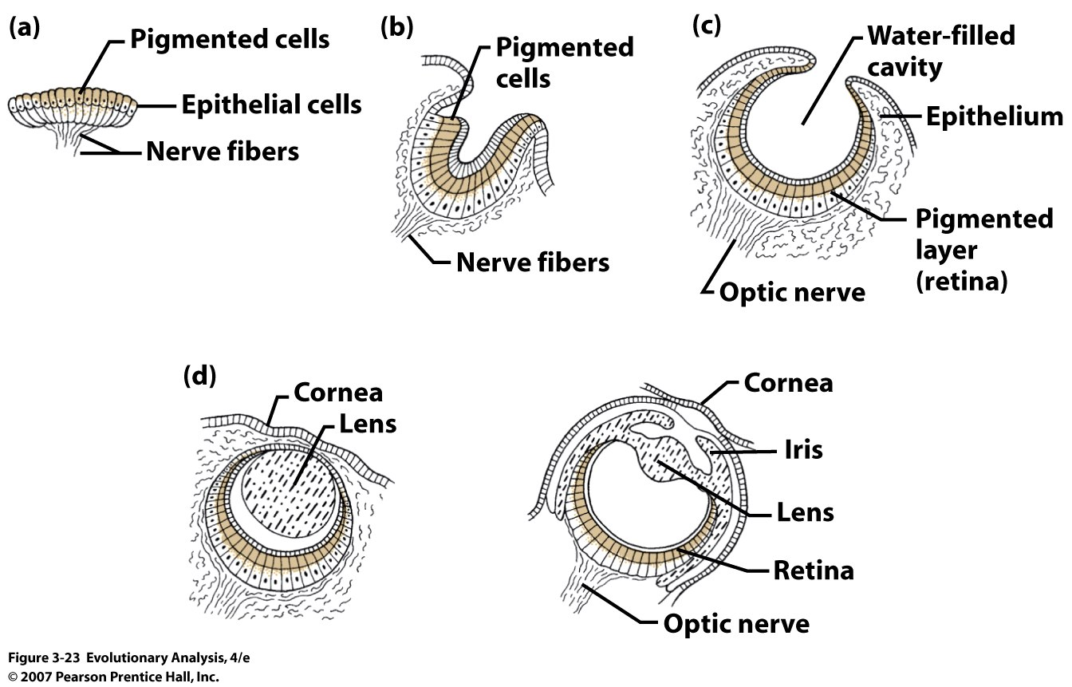
shrimp
Pigment spot Pigment cup Pigment cup ++
Flat and segmented
worms etc.,
Copepod crustaceans
Octopus, Vertebrates, etc.
Complex eye
Notes:
Figure 3.23 Variation in mollusc eyes
A pigment spot; (b) a simple pigment cup; (c) the simple optic cup found in abalone; (d) the complex lensed eyes of a marine snail called Littorina and the octopus. Pigmented cells are shown in color. From Brusca and Brusca 1990.
Here's how some scientists think some eyes may have evolved:
The simple light-sensitive spot on the skin of some ancestral creature gave it some tiny survival advantage, perhaps allowing it to evade a predator.
Random changes then created a depression in the light-sensitive patch, a deepening pit that made "vision" a little sharper. At the same time, the pit's opening gradually narrowed, so light entered through a small aperture, like a pinhole camera. Every change had to confer a survival advantage, no matter how slight. Eventually, the light-sensitive spot evolved into a retina, the layer of cells and pigment at the back of the human eye.
Over time a lens formed at the front of the eye. It could have arisen as a double-layered transparent tissue containing increasing amounts of liquid that gave it the convex curvature of the human eye. In fact, eyes corresponding to every stage in this sequence have been found in existing living species. The existence of this range of less complex light-sensitive structures supports scientists' hypotheses about how complex eyes like ours could evolve.
The first animals with anything resembling an eye lived about 550 million years ago. And, according to one scientist's calculations, only 364,000 years would have been needed for a camera-like eye to evolve from a light-sensitive patch.

Slide 38
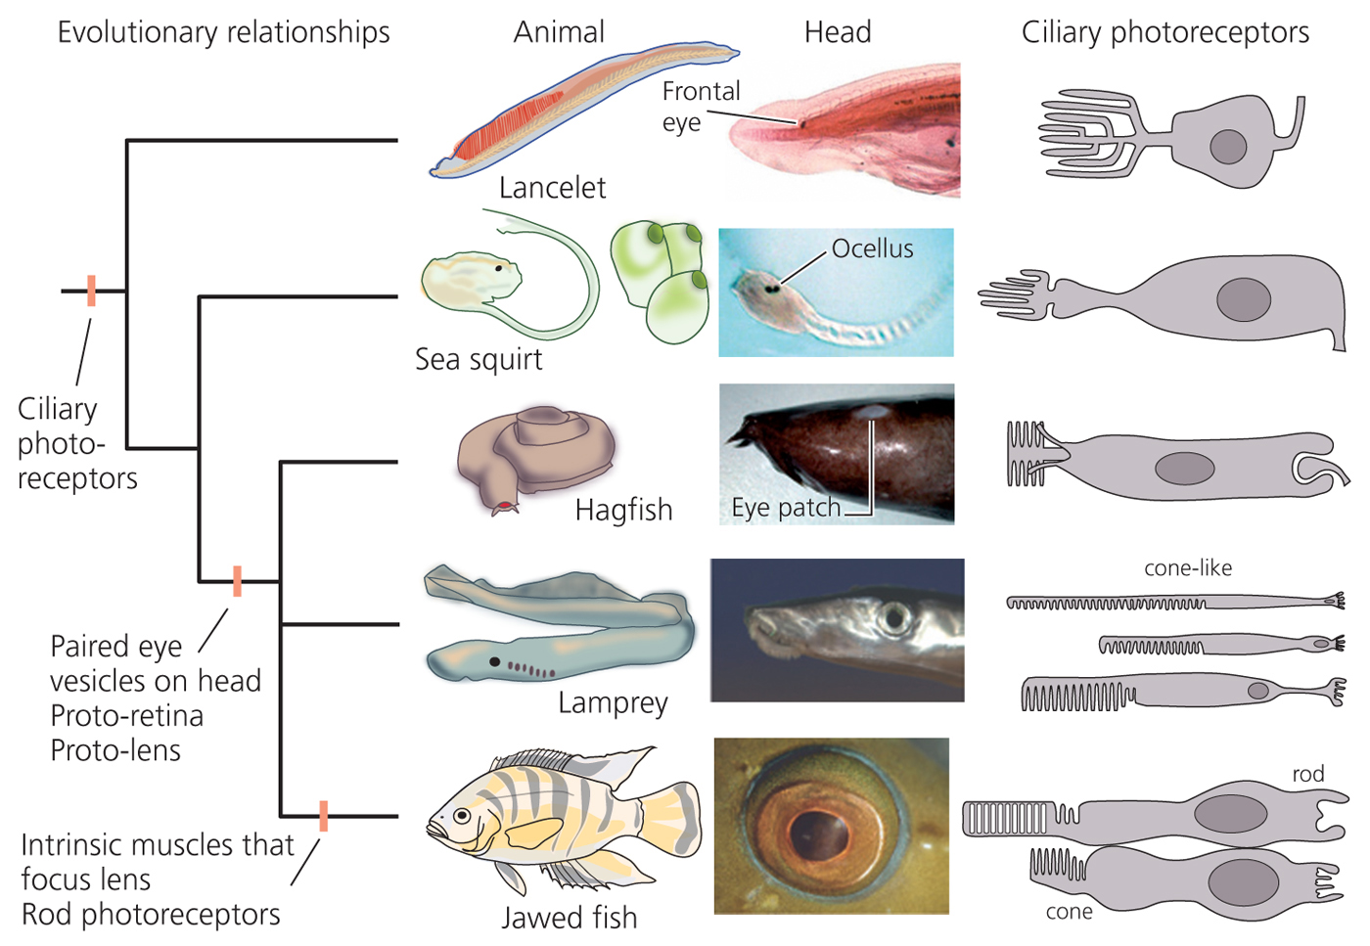
Chordate eyes of varying complexity

Slide 39
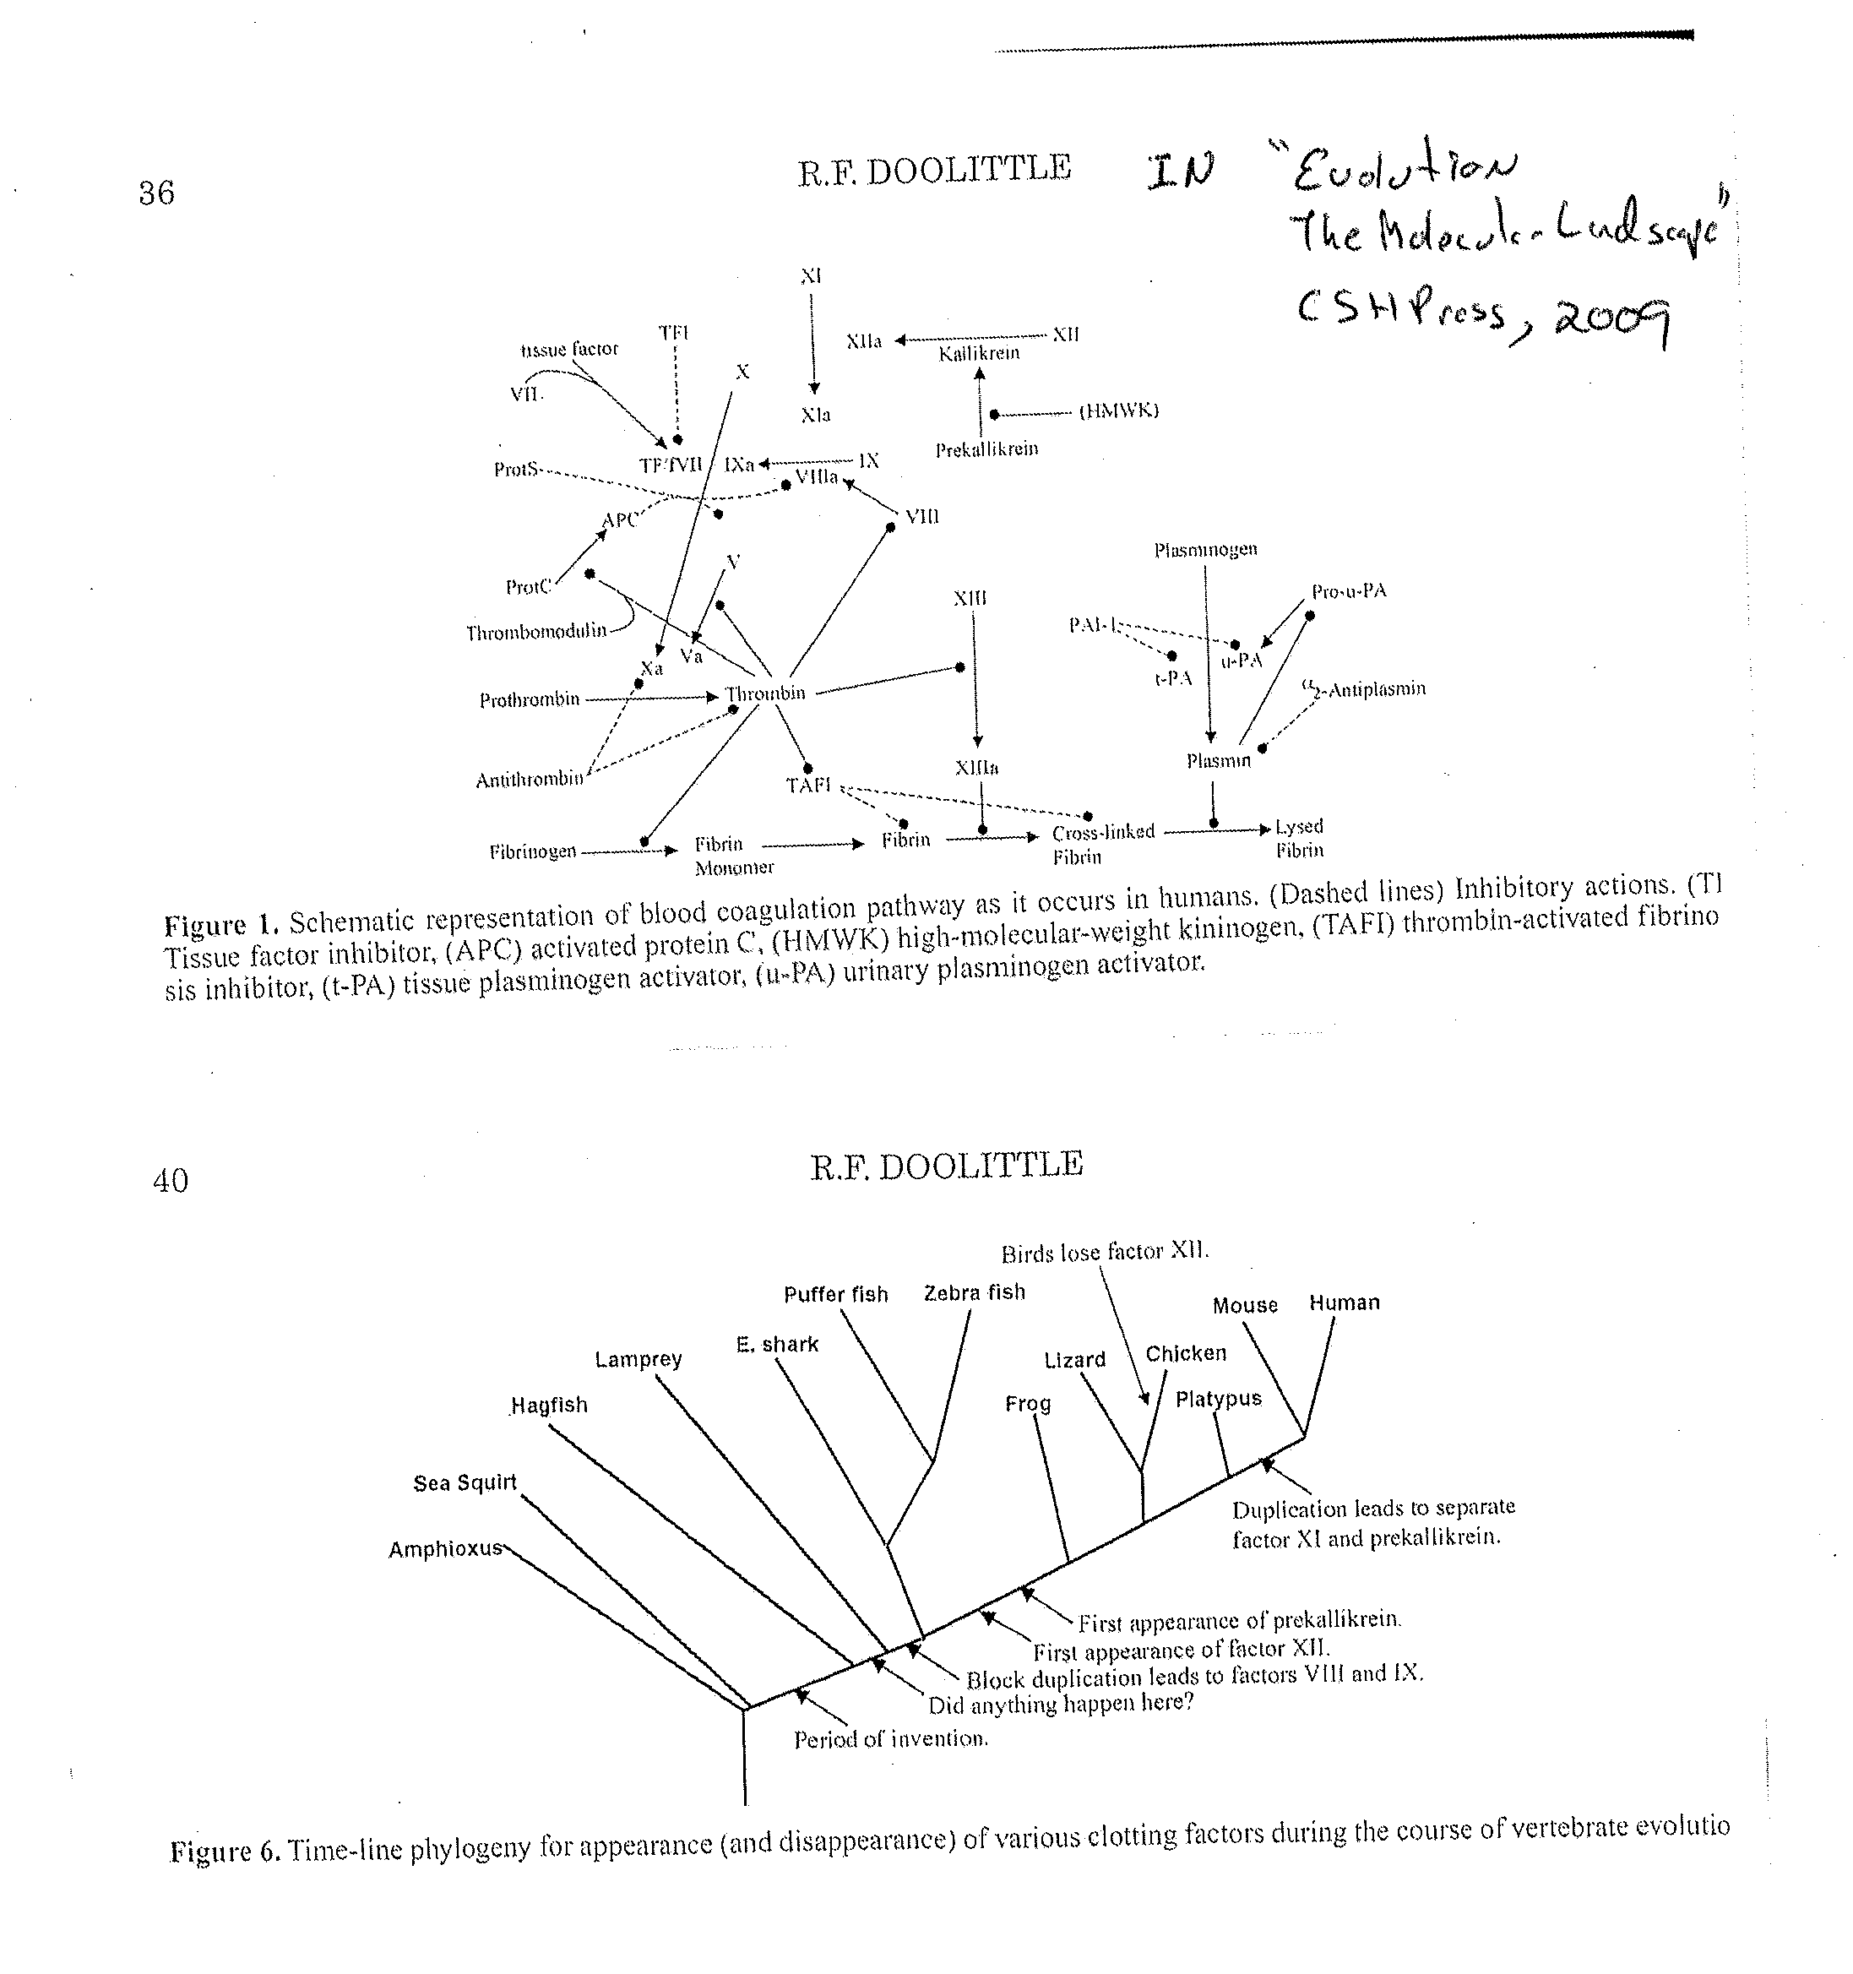
Evolution of vertebrate blood clotting system:
R. F. Doolittle, IN: Evolution The Molecular Landscape, CSH, 2009
http://www.millerandlevine.com/km/evol/DI/clot/Clotting.html
Notes:
Increased blood pressure was selective factor

Slide 40
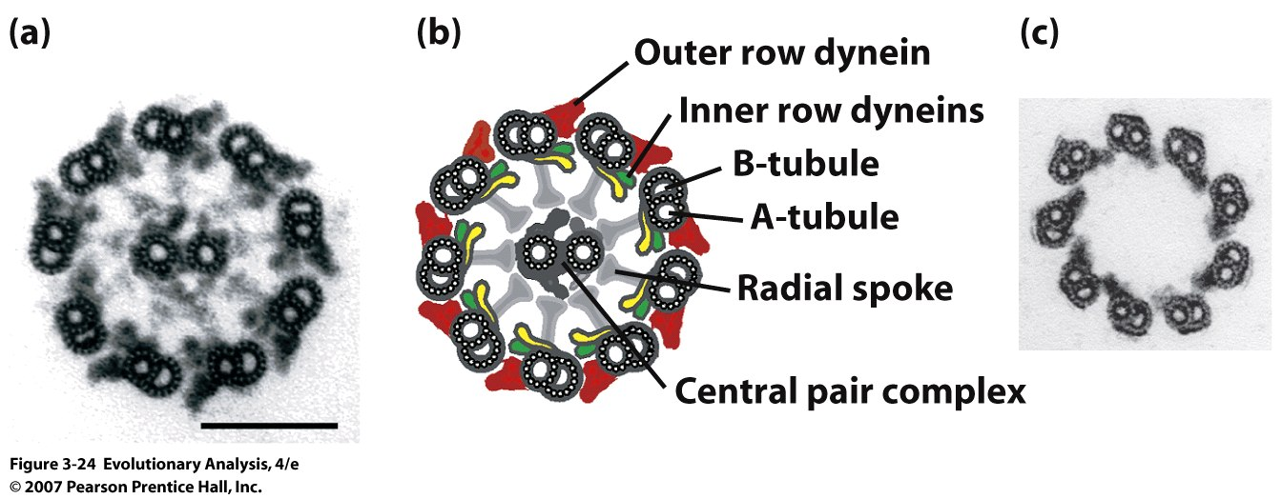
Eukaryotic flagella, impossibly complex??
Simpler but
fully functional
(eel sperm)
Notes:
Figure 3.24 Eukaryotic flagella
(a) An electron micrograph showing a cross section through a flagellum of the single-celled alga Chlamydomonas. Scale bar = 100nm. (b) An interpretive drawing showing the individual components of the flagellum in (a). (c) A cross section through the flagellum of an eel sperm. See text for explanation. Parts (a) and (b) are from Mitchell (2000); (c) is from Woolley (1997).

Slide 41
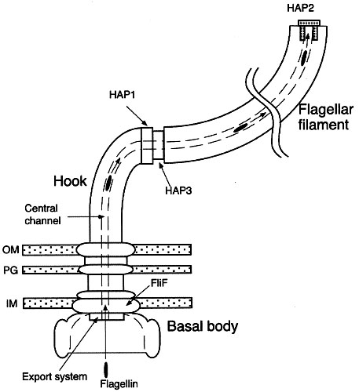
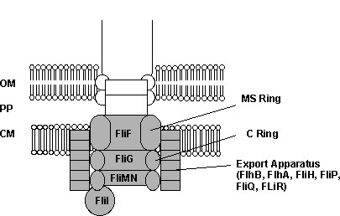
The eubacterial flagellum. The flagellum is an ion-powered rotary motor, anchored in the membranes surrounding the bacterial cell. This schematic diagram highlights the assembly process of the bacterial flagellar filament OM, outer membrane; PG, peptidoglycan layer; IM, cytoplasmic membrane (From Yonekura et al 2000).
Extensive homologies between type III secretory
proteins and proteins involved in export in the basal
region of the bacterial flagellum. These homologies
demonstrate that the bacterial flagellum
is not "irreducibly complex." In this diagram
(redrawn from Heuck 1998), the shaded portions
of the basal region indicate proteins in the E. coli
flagellum homologous to the Type III secretory
structure of Yersinia. OM, outer membrane;
PP, periplasmic space; CM, cytoplasmic membrane.
Notes:
Http://en.wikipedia.org/wiki/Yersinia, pathogen, uses needle like structure to inject harmful products into the cell
Stated directly, the TTSS does its dirty work using a handful of proteins from the base of the flagellum. From the evolutionary point of view, this relationship is hardly surprising. In fact, it's to be expected that the opportunism of evolutionary processes would mix and match proteins to produce new and novel functions. According to the doctrine of irreducible complexity, however, this should not be possible. If the flagellum is indeed irreducibly complex, then removing just one part, let alone 10 or 15, should render what remains "by definition nonfunctional." Yet the TTSS is indeed fully-functional, even though it is missing most of the parts of the flagellum. The TTSS may be bad news for us, but for the bacteria that possess it, it is a truly valuable biochemical machine.
The existence of the TTSS in a wide variety of bacteria demonstrates that a small portion of the "irreducibly complex" flagellum can indeed carry out an important biological function. Since such a function is clearly favored by natural selection, the contention that the flagellum must be fully-assembled before any of its component parts can be useful is obviously incorrect. What this means is that the argument for intelligent design of the flagellum has failed.

Slide 42
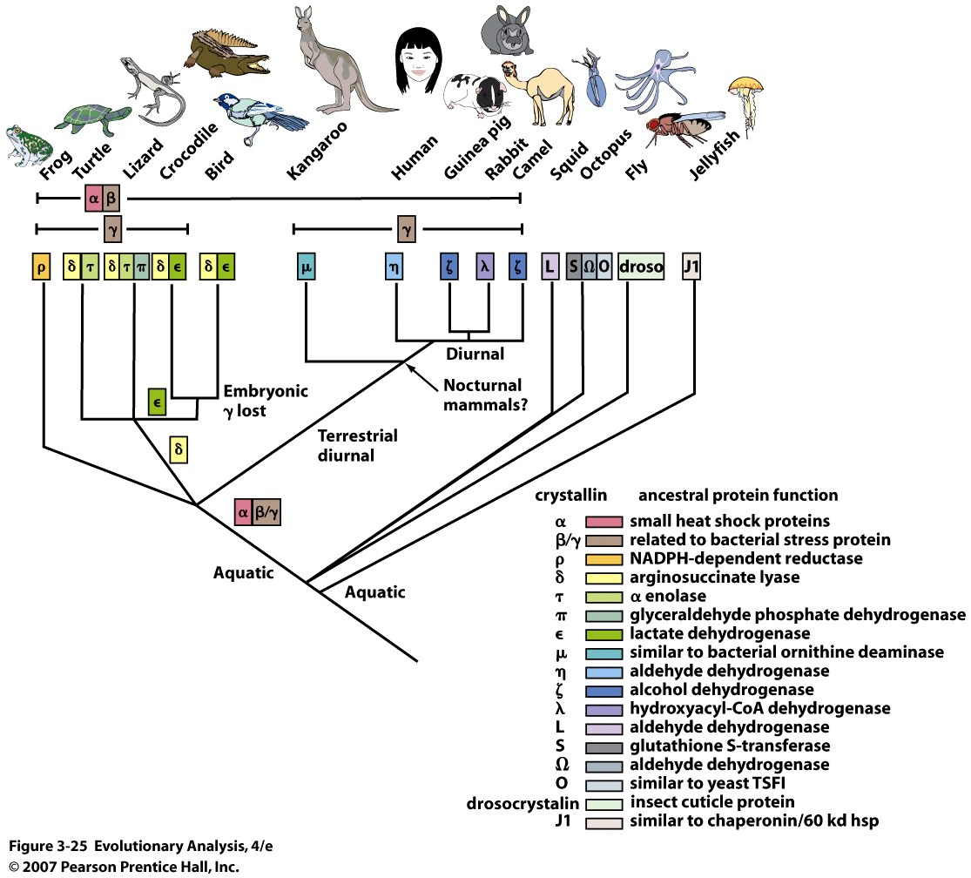
Gene co-option in the crystallins (H₂O soluble proteins)
of animal eye lenses
Notes:
Figure 3.25 Gene co-option in the crystallins of animal eye lenses
Crystallin proteins are major components of the lenses in animal eyes. All are derived from proteins with other functions. In some cases crystallins are encoded by duplicates of the genes for the proteins they are derived from; in other cases crystallins are encoded by the same genes. This phylogeny shows the evolutionary relationships among a variety of animals. The color-coded Greek letters indicate the crystallins found in the lenses of each animal. The table lists the proteins the various crystallins are derived from. Redrawn from True and Carroll 2002.

Slide 43
XI. Conclusion
Many examples of natural and artificial selection
Natural selection creates adaptations in steps
Mutation and genetic recombination can lead to new genetic variants that were not previously observed

